Slide 1


Mini Project
PIZZERIA
Every Hunger’s Destination
IGATE is now a part of Capgemini
Notes:
Copyright © 2011 IGATE Corporation (a part of Capegemini Group). All rights reserved.
No part of this publication shall be reproduced in any way, including but not limited to photocopy, photographic, magnetic, or other record, without the prior written permission of IGATE Corporation (a part of Capegemini Group).
IGATE Corporation (a part of Capegemini Group) considers information included in this document to be confidential and proprietary.

Slide 2

Team Members
Ishita Gaur
S R Shreyash
Biswajit Deb
M.Reshma
V Soma Sekhar
Debanjan Das

Slide 3
Project Details
Custom pizza ordering application was created for customers of a Pizzeria to create their orders online. The pizzeria has been taking orders by phone for a long time and they wanted to add the option for customers to create orders online.
Our solution provides the ordering of Custom Pizzas which consists of a selection of ingredients for pizzas. The application allows customers to place order for Pizza.

Slide 4


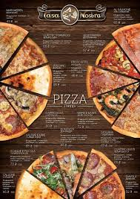





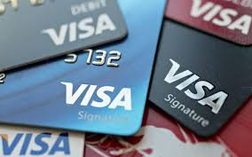
Diagram Depicting Entire Project

Slide 5
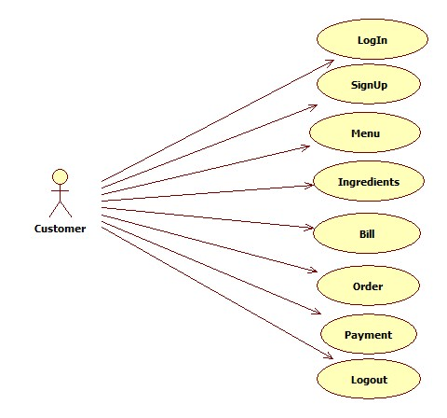
Use Case Diagram

Slide 6
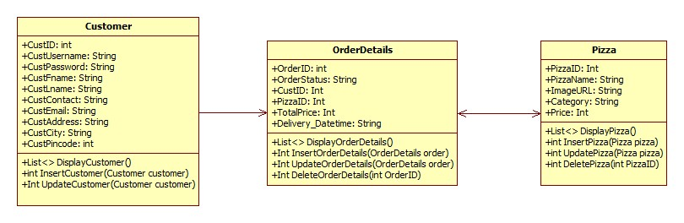
Class Diagram

Slide 7
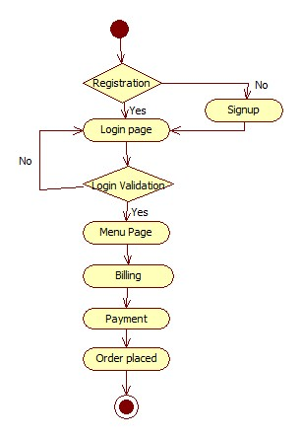
Sequence/Activity Diagram

Slide 8
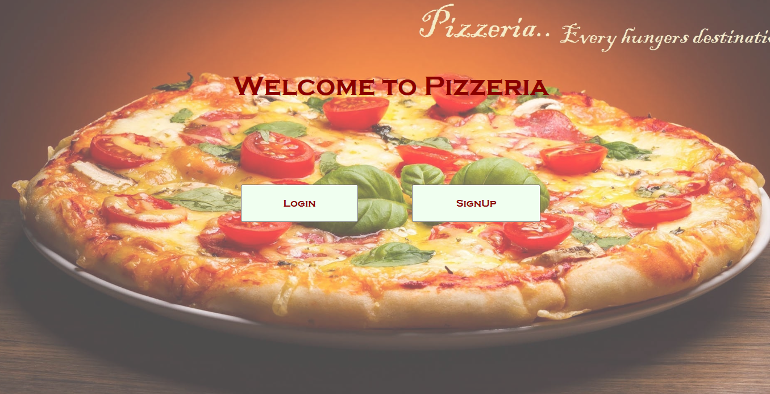
Screen shots

Slide 9
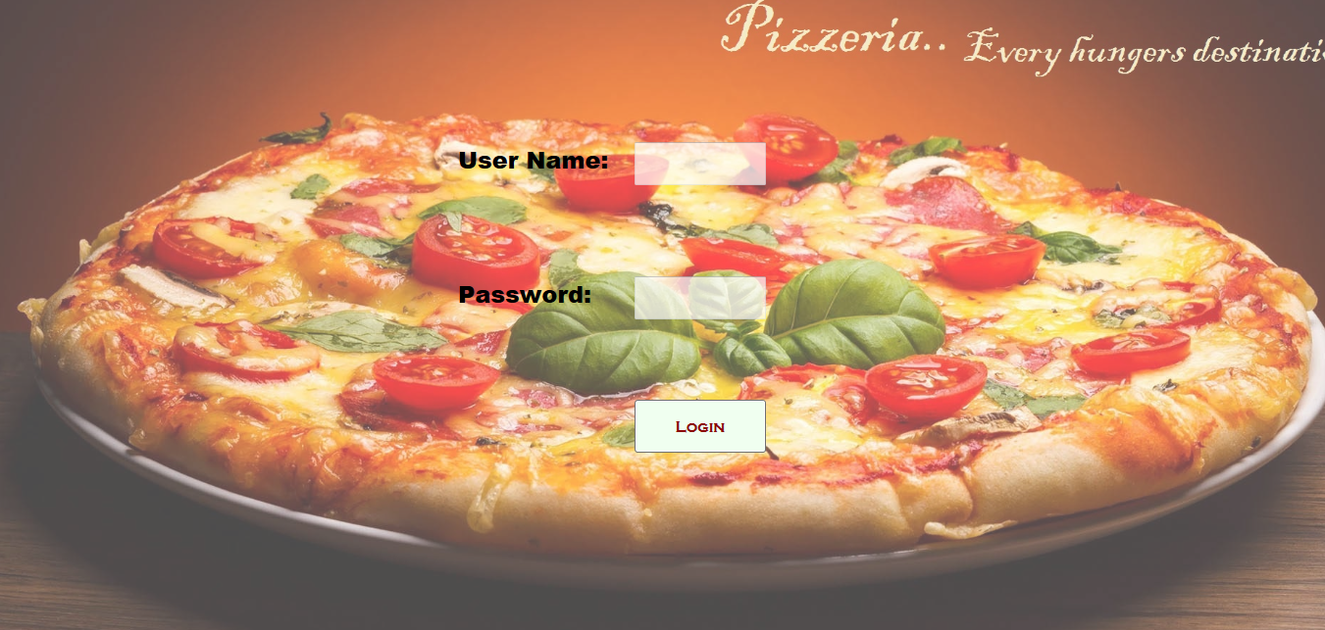
Screen shots

Slide 10
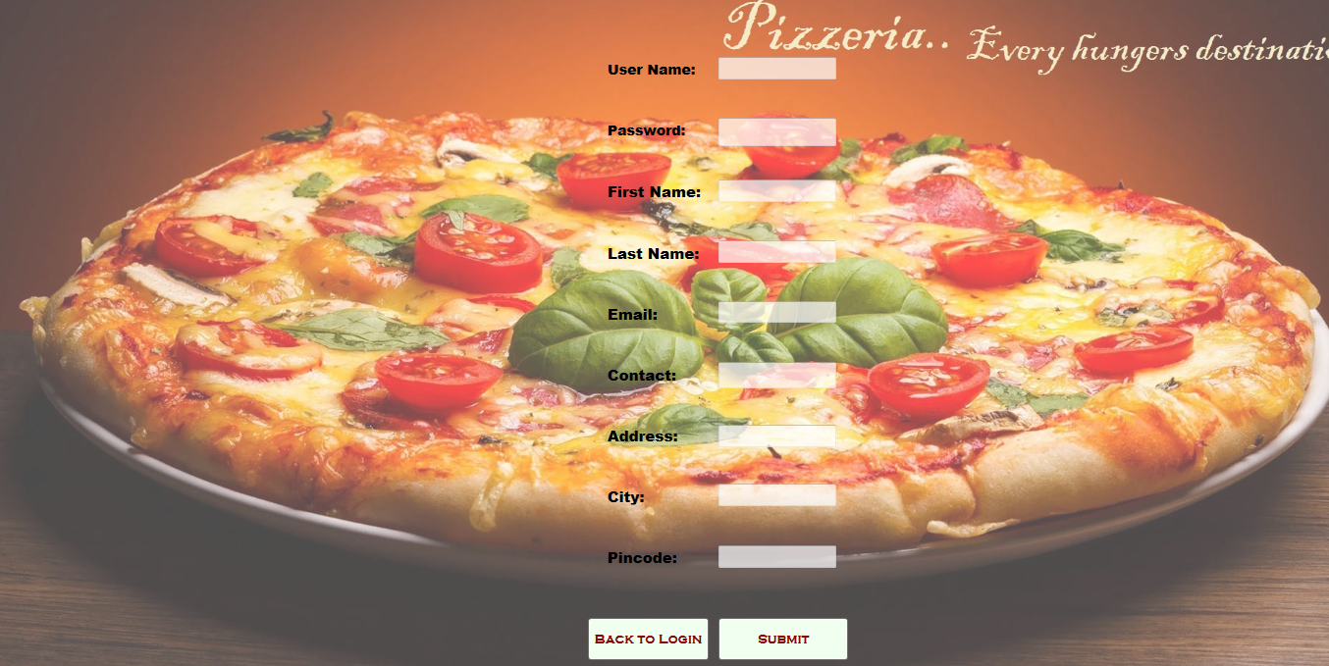
Screen shots

Slide 11
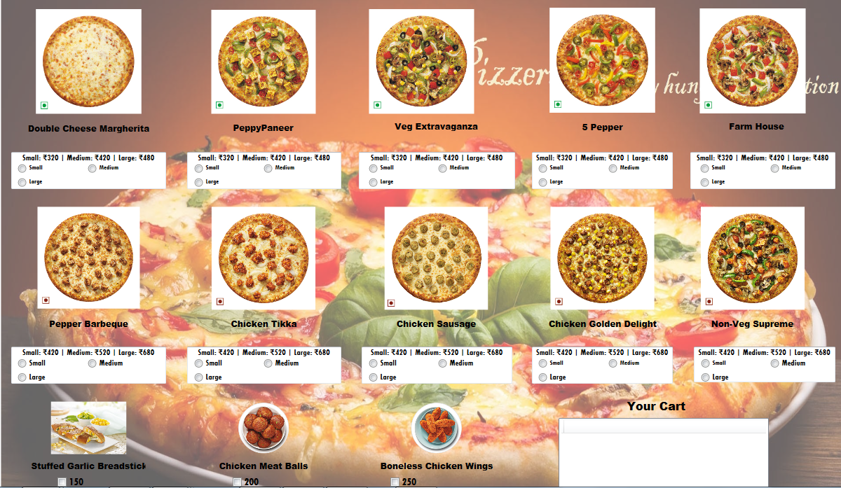
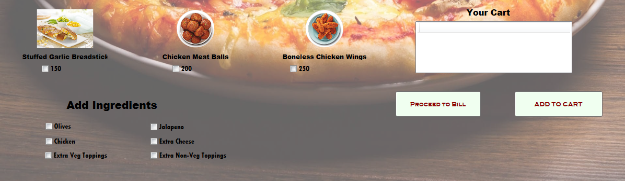
Screen shots

Slide 12
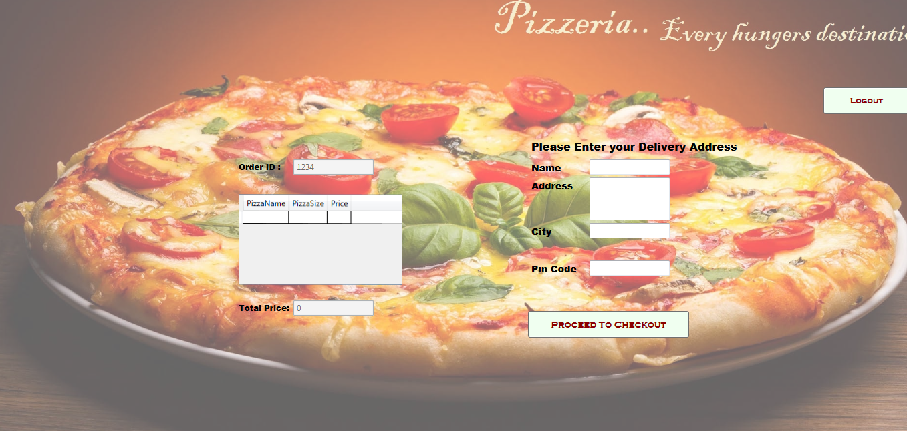
Screen shots

Slide 13
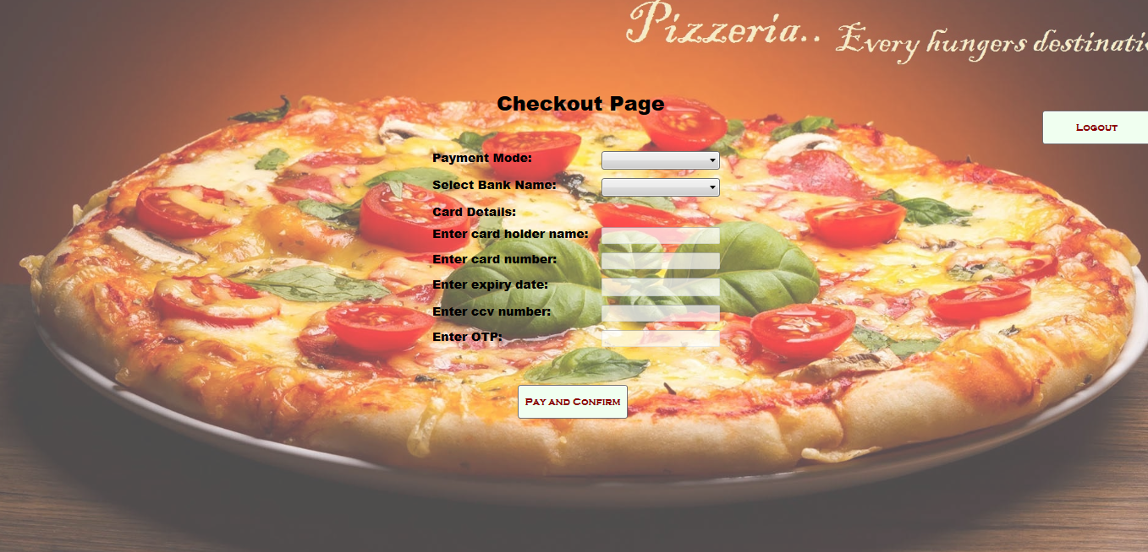
Screen shots

Slide 14
Future Enhancements
Employee and Admin Entities can be added to enable further functionalities.
The Project can be converted into ASP.NET MVC and Web API.
We can implement Tracking System for the live status and update the customer through SMS.

Slide 15


